Slide 1
Supplemental Slides
How to systematically evaluate
a classifier-based predictive model？
English Version
Author: Kunru Song

Slide 2
Golden standard
or
Some reference
Output
Correct predicting
Predicted label (predicted outcome)
Actual label
(Ground truth)
Accuracy
=
Total sample
Predicted positive
Ture positive
Using accuracy alone to evaluate the performance of a classifier is biased and incomplete.
Accuracy ignores the following situations:
missed cases (false negatives.
true positives but predicted as negatives),
misdiagnosed cases (false positives.
true negatives but predicted as positives).
Predicted negative
True negative

Slide 3
The performance of a classifier can be demonstrated through a confusion matrix.
Limitations of Accuracy: Example
ACC=50%
ACC=50%
True Conditions
TP
0
FP
0
TP
50
FP
50
Total Sample
Actual Positive
Actual Negative
FN
50
TN
50
FN
0
TN
0
Predicted Positive
True Positive, TP
False Positive, FP
N=100;
Two classifiers have the same accuracy but their actual performance is completely different
Predicted Conditions
Predicted Negative
False Negative, FN
True Negative, TN
ACC=90%
ACC=90%
TP
0
FP
0
TP
90
FP
10
FN
10
TN
90
FN
0
TN
0
N=100; 90:10 or 10:90
Due to the imbalance of the sample itself, the ACC of the classifier is biased

Slide 4
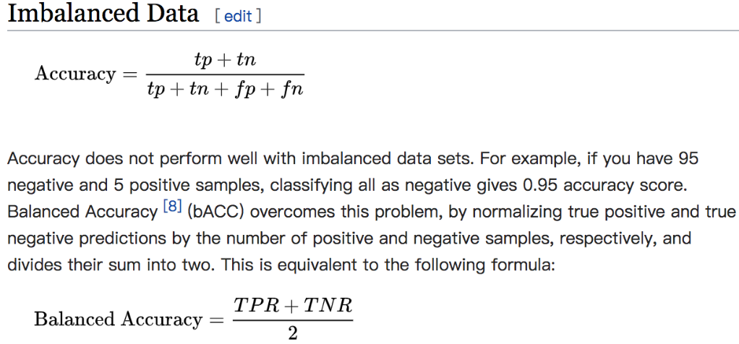
Recommendation: using balanced ACC

Slide 5
Advantages of balanced ACC: Example
True Conditions
True Conditions
Total Sample
Actual Positive
Actual Negative
Actual Positive
Actual Negative
Predicted Positive
TP
50
FP
0
TP
10
FP
0
Predicted Conditions
Predicted Negative
FN
0
TN
50
FN
0
TN
90
Balanced Data
Balanced ACC =100%
Imbalanced Data
Balanced ACC=100%

Slide 6
More Indices from confusion matrix
True Conditions
Total Sample
Actual Positive
Actual Negative
Predicted Positive
TP
True Positive, TP
FP
False Positive, FP
Positive Predictive Value, PPV/
Precision
False Discovery Rate, FDR
missed cases
Predicted Conditions
Predicted Negative
FN
False Negative, FN
TN
True Negative, TN
False Omission Rate, FOR
Negative Predictive Value, NPV
True Positive Rate, TPR; Sensitivity
False Positive Rate, FNR
Accuracy
False Negative Rate, FNR
True Negative Rate, TNR; Specificity
misdiagnosed cases

Slide 7
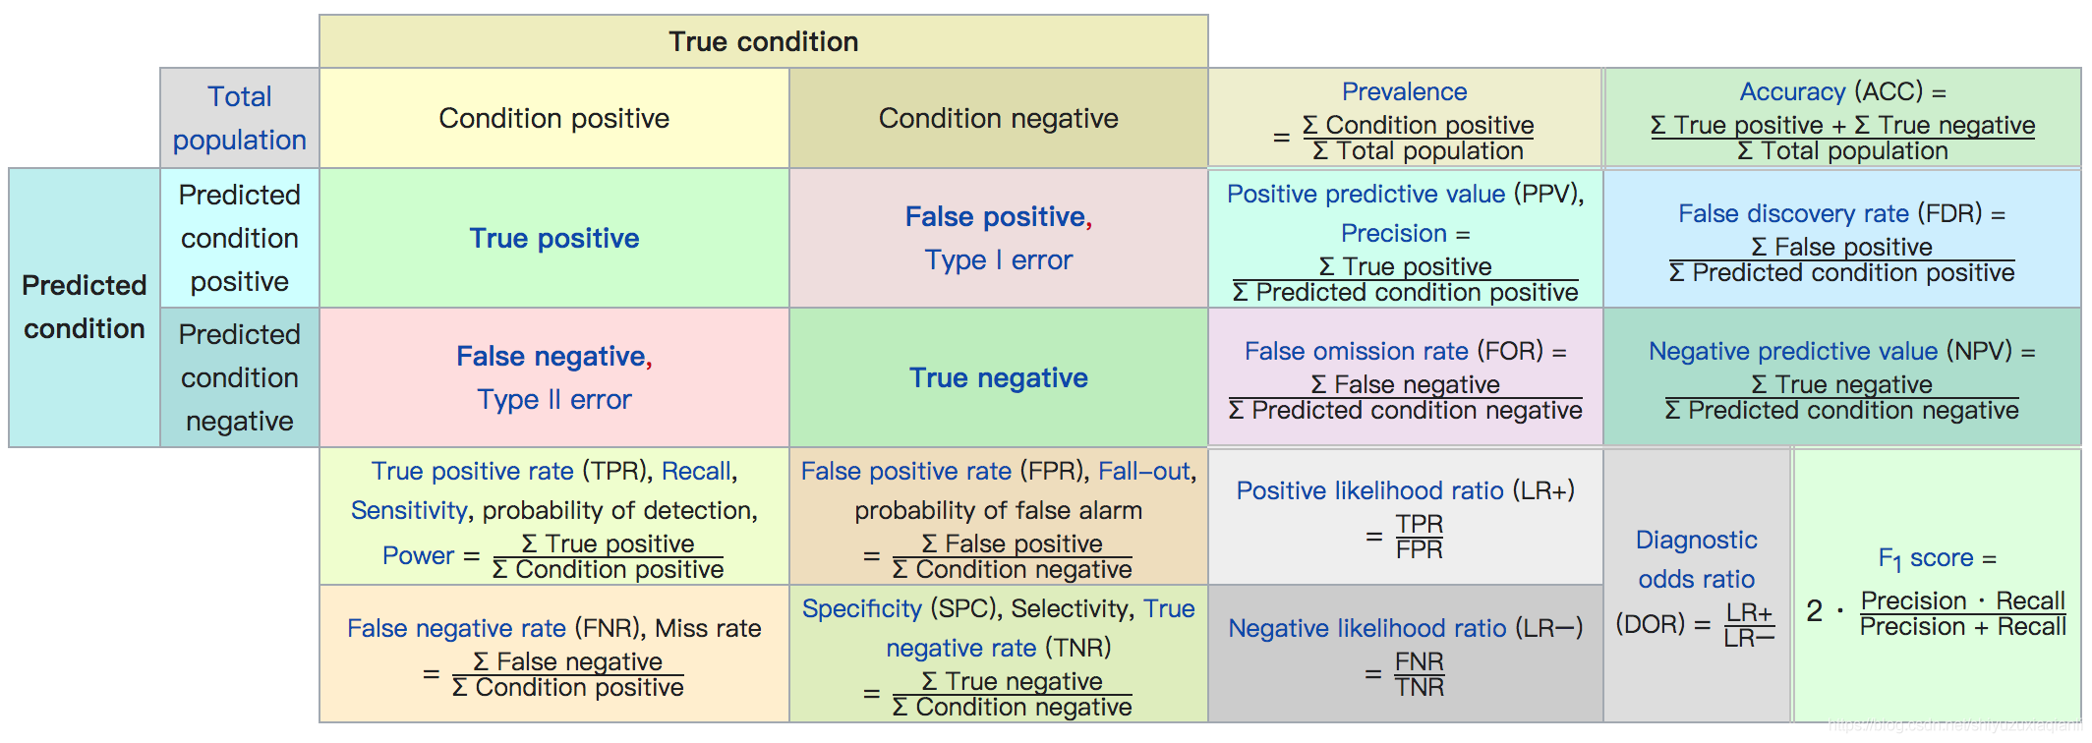
A comprehensive view of confusion matrix

Slide 8
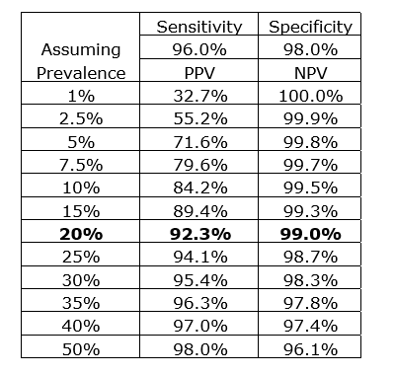
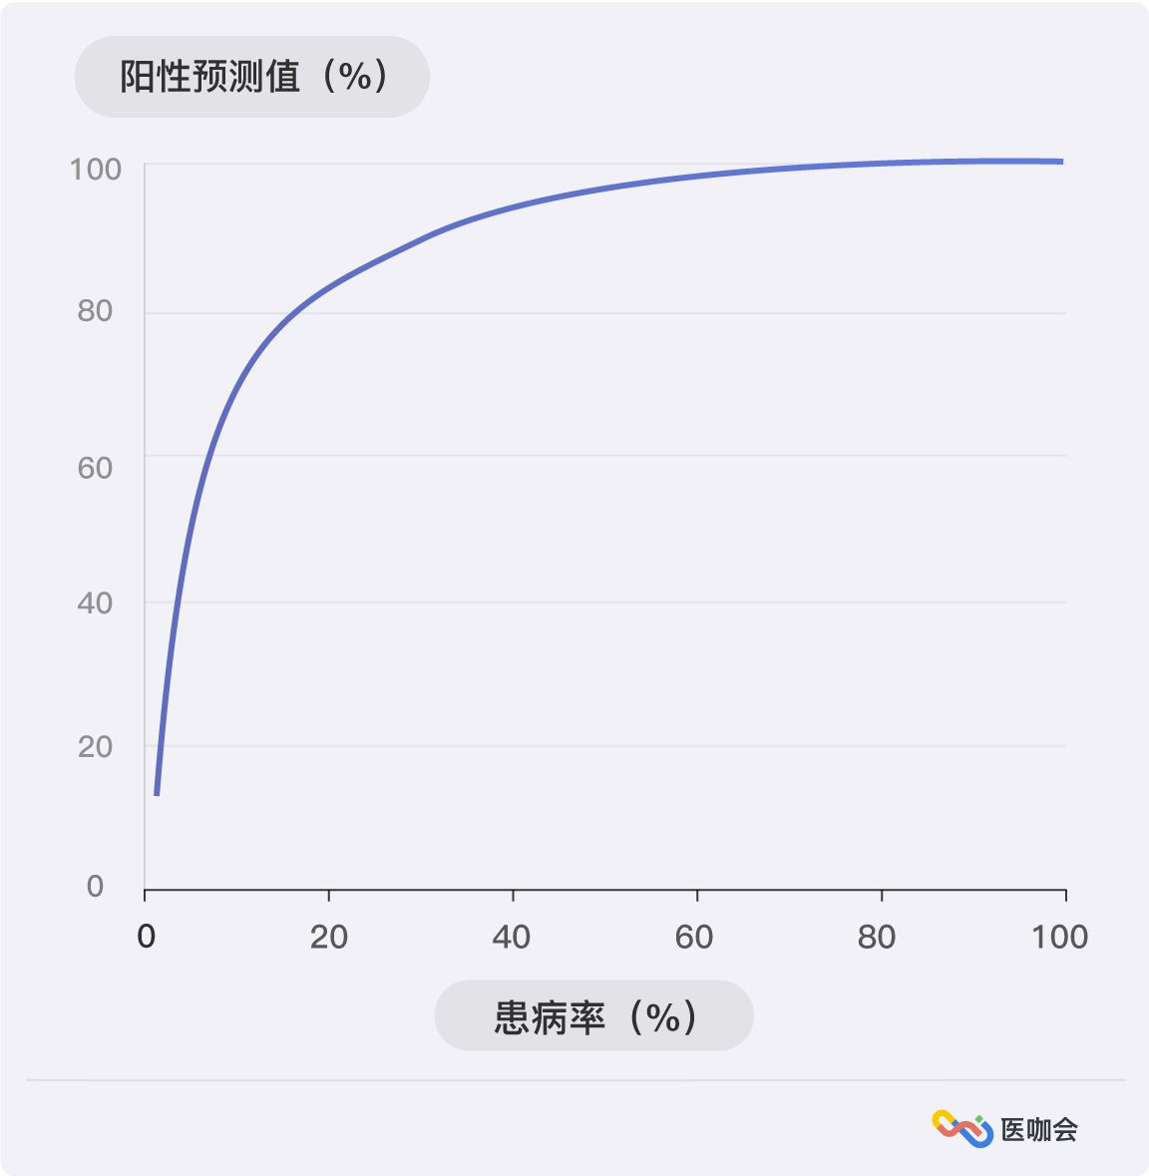
PPV and NPV are influenced by the prevalence of the disease.
If a diagnostic tool (e.g. predictive model) has a constant sensitivity and specificity, the expected NPV and PPV vary with the prevalence of the disease,
as shown in the following table.
The higher the prevalence of a disease, the higher the positive predictive value.
If we conduct a diagnostic test in a high-risk population, we can obtain more efficient results and avoid wasting manpower and resources.
Additionally, in clinical applications of diagnostic tests, we also need to analyze the results based on the prevalence rate.
Notes:
https://zhuanlan.zhihu.com/p/25164465

Slide 9
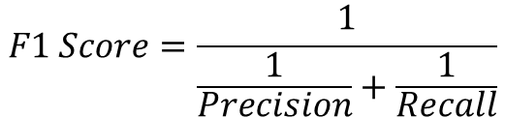
Commonly used classifier performance evaluation indices
TP
True Positive
FP
False Positive
FN
False Negative
TN
True Negative
Sensitivity/Recall:
The ability to detect positive individuals among the true positives
Sensitivity; TPR
TP
Recall
=
TP
+
FN
Specificity; TNR;
TN
Specificity: The ability to detect negative individuals among the true negatives
$$F1 Score=\frac{1}{\frac{1}{Precision}+\frac{1}{Recall}}$$
=
TN
+
FP
Positive Predictive Value, PPV
TP
Precision
Positive Predictive Value/
Precision:
The proportion of individuals detected as positive that are truly positive
=
TP
+
FP
Notes:
一个好的分类器，理想情况下，应同时具备：
高准确率、高敏感性、高特异性
以及高F1 Score

Slide 10
ROC curve and P-R curve
Individuals
IAT Score
Individuals
Classifier Output (Posterior Probability)
95
0.9
90
0.8
cut-off = 80
cut-off = 0.5
20
0.2
15
0.1
IAT: Young’s Internet Addiction Test

Slide 11

TP
True Positive
FP
False Positive
FN
False Negative
TN
True Negative
ROC Curve
Sensitivity; TPR
TP
=
TP
+
FN
Specificity; TNR;
TN
=
TN
+
FP
False Positive Rate, FNR
FP
=
= 1-
Specificity; TNR;
TN
+
FP
The significance of the ROC curve
regardless of the output values of the classifier, how well does my model perform in a general sense, and how balanced is the trade-off between the true positive rate (TP) and false positive rate (FP)

Slide 12
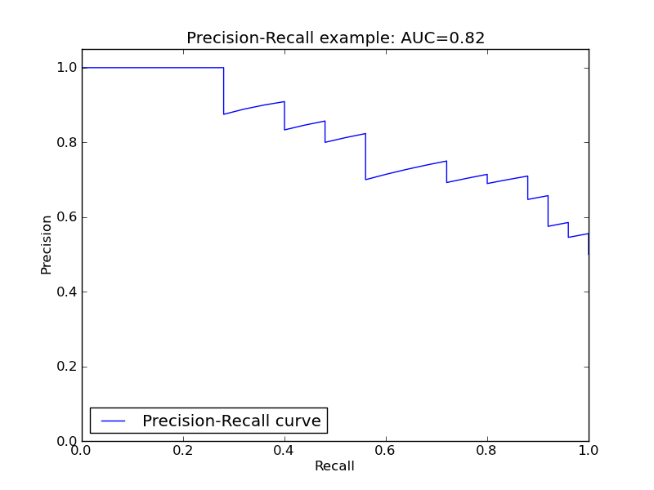
TP
True Positive
FP
False Positive
FN
False Negative
TN
True Negative
Sensitivity; TPR
TP
Recall
=
TP
+
FN
Sensitivity/Recall: The ability to detect positive individuals among the true positives
Positive Predictive Value, PPV
TP
Precision
=
TP
+
FP
Positive Predictive Value/Precision: The proportion of individuals detected as positive that are truly positive
P-R curve
The significance of P-R curve
“It is better to wrongly kill one than to let one go”
Under reasonable precision, seek the highest recall to achieve a balance between precision and recall.

Slide 13
Summary: How to evaluate a classifier holistically
1. Always test the performance of the classifier on new samples (evaluate generalizability):
For example: Cross-validation, independent sample validation, cross-site validation
2. Report the confusion matrix directly
TP
True Positive
FP
False Positive
FN
False Negative
TN
True Negative
3. Report accuracy, as well as sensitivity, specificity, F1-score, and other metrics
Depending on the research objectives, it may be necessary to consider reporting PPV and NPV
4. Report the ROC curve or P-R curve and report the area under the curve (AUC)

